Slide 1
2019年高考英语试题对教学的反拨作用分析
北京市英语特级教师 程惠云
Notes:
大家好！2017年的《英语学科考试大纲》已经面世。正如大家所见，与16年的考试大纲相比较，17年的《英语学科考试大纲》几乎没有什么变化。自从2014年英语试卷结构发生变化以来，15，16年的试卷保持了很好的稳定性。可以断定2017年也将在坚持整体稳定的前提条件下，稳健地推进改革创新

Slide 2
目 录
评价改革方向
测试理念
高考试卷分析

Slide 3
高考评价体系：基于德智体美劳全面发展
《国务院关于深化考试招生制度改革的实施意见》：深化高考考试内容改革、规范高考命题。

Slide 4
英语学科命题理念：基于问题情境 考查综合语言运用能力
程晓堂：核心素养的关键点是解决问题的能力，核心素养是在解决问题的过程中培养的。因此，核心素养的测评也应该强调问题和情景。
听（说）的能力
知识运用聚焦（填空、完形）
阅读理解能力聚焦
侧重考查阅读能力！！！
书面表达能力

Slide 5
2019全国高考英语试题8套
全国卷I：河南、河北、山西、江西、湖北、湖南、广东、安徽、福建、
山东
全国卷Ⅱ：甘肃、青海、内蒙古、黑龙江、吉林、辽宁、宁夏、新疆、
陕西、重庆、海南
全国卷Ⅲ：云南、广西、贵州、四川、西藏
北京卷
天津卷
江苏卷
浙江卷
上海卷
大同小异、神似形异、重基础、查综合、考应用、讲创新

Slide 6
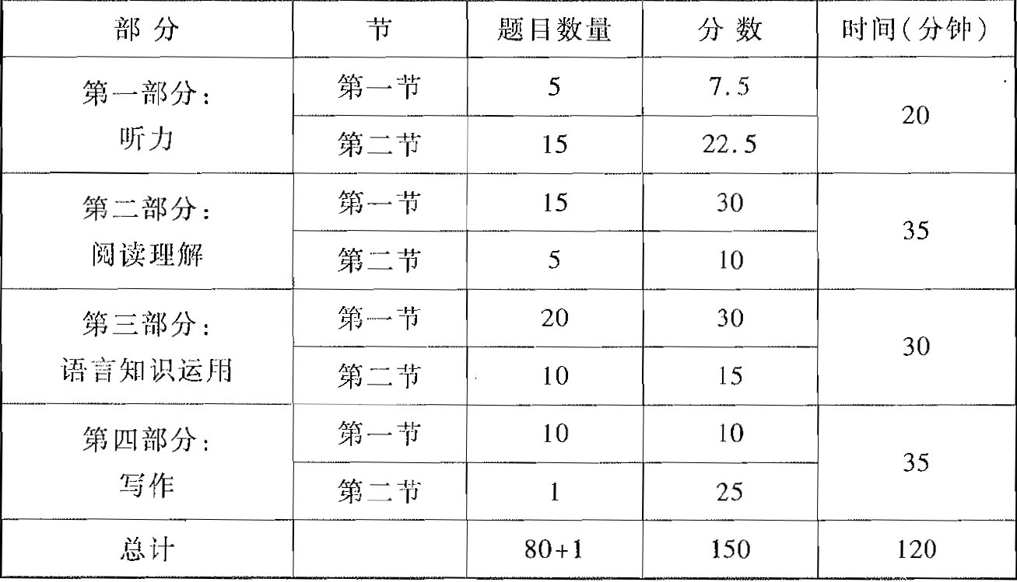
【全国卷I】 结构稳定 内容创新
2012—今
重问题情景—语篇
四层考查内容
必备知识、关键能力、
学科素养、核心价值
四翼考查要求：
基础性、综合性、
应用性、创新性

Slide 7
试题分析
选材特点：题材广泛，围绕人与自然、人与社会、人与自我三大主题。
2019年高考全国I卷、全国II卷听力试题中涉及到的话题（荆州刘萍）
年份 | 第一节(Text) |  |  |  |  | 第二节(Text)
 | 1 | 2 | 3 | 4 | 5 | 6 | 7 | 8 | 9 | 10
19年卷I | 探病时间 | 报健身课 | 约在酒吧 | 电话求职 | 邀约听音乐会 | James破产失业 | 老年人重返校园 | 采访父母对子女的就业影响 | 谈论锻炼的益处 | 新闻：保护海鸟
19年卷II | 书店买书 | 上舞蹈课 | 结账 | 更改约定时间 | 同事辞职 | 买伞 | 询问周末活动 | 电话约见面时间 | 发放工作录用通知 | 人物介绍
18年卷I | 看电视节目 | 买唱片 | 赶火车 | 上下班交通方式 | 生病缺课 | 重返学校 | 介绍宾馆 | 餐厅偶遇谈论是否去音乐会 | 看房租房 | 谈教育的重要性
评价：情景贴近生活，语言原汁原味、 立意积极。6. The woman is concerned.
变化点：Text 9 设题4个； Text 10设题3个；话题：失业、父母与子女的关系、同事辞职

Slide 8
听力试题常用情景
日常活动：与朋友谈论计划和安排，如旅行、交通、天气状况、聚会餐饮、周末活动、赠送礼物、是否拍照、向陌生人或朋友求助、问路、问时间、询问物品价格、医院探望病人、租房和谈论周边环境等。
工作学习交流：与同事谈论因身体不适不知如何完成工作报告，谈论应聘失业等事宜，谈论因公出差及相关的天气、饮食、家庭成员的安排，谈论对人和事物的评价，如发表对书籍、电影或人物等的看法。
介绍人物事物：介绍小镇地理和交通情况，根据自身经历介绍大城市与小城市之间交通、娱乐、安全等方面的异同，介绍英国伦敦的茶叶交易市场、美国大学生的就业情况，导游介绍旅行安排，介绍某地天气情况以及介绍自己对教育的认识等。

Slide 9
【阅读语篇】选材面广 内容丰富
附录IV 话题范围
1. 个人情况 (Personal information)
2. 家庭、朋友与周围的人 (Family,
friends and people around)
3. 周围的环境 (Personal
environments)
4. 日常活动 (Daily routines)
5. 学校生活 (School life)
6. 兴趣与爱好 (Interests and hobbies)
7. 个人感情 (Emotions)
8. 人际关系 (Interpersonal
relationships)
9. 计划与愿望 (Plans and intentions)
10. 节假日活动 (Festivals, holidays
and celebrations)
11. 购物 (Shopping)
12. 饮食 (Food and drink)
13. 健康 (Health)
14. 天气 (Weather)
15. 文娱与体育 (Entertainment and
sports)

Slide 10
【命题思路二】选材面广 内容丰富（3）
话题范围
16. 旅游和交通 (Travel and transport)
17. 语言学习 (Language learning)
18. 自然 (Nature)
19. 世界与环境 (The world and the
environment)
20. 科普知识与现代技术 (Popular
science and modern technology)
21. 热点话题 (Topical issues)
22. 历史与地理 (History and geography)
23. 社会 (Society)
24. 文学与艺术 (Literature and art)

Slide 11
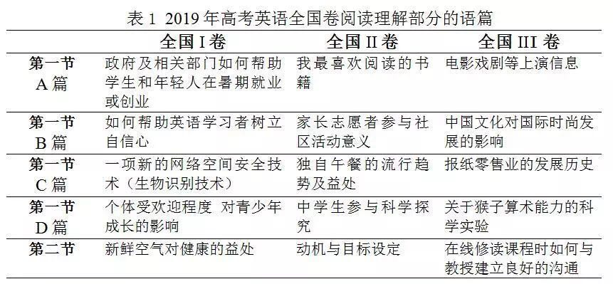
选材特点：
语言原汁原味
时代感强
贴近生活
题材丰富 体裁多样

Slide 12
选材特点：选材面广 内容丰富（2）
 | 全国卷I | 全国卷II | 全国卷III
完 形 | 说明文：非洲乞力马扎罗的环境污染整治问题 | 记叙文：帮助迷路的狗返回家园 | 说明文：高科技使得峡谷底见天日
1）所选语篇尽量与中学生或青少年的学习和生活有直接关联，如：政府及相关部门如何帮助学生和年轻人在暑期就业或创业、如何帮助英语学习者树立自信心、个体受欢迎程度对青少年成长的影响、中学生参与科学探究、动机与目标设定；
2）所选语篇符合中学生的知识和经验水平，能够帮助中学生获得新的知识或经验，如：一项新的网络空间安全技术、新鲜空气对健康的益处、家长志愿者参与社区活动意义、在线修读课程时如何与教授建立良好的沟通；非洲乞力马扎罗的环境污染整治问题
3）所选语篇体裁多样（以往的高考试题采用的故事和叙述类语篇较多），且结构相对完整（以往试题采用的节选语篇偏多），有利于给学生带来更加接近真实的阅读体验。

Slide 13
阅读材料来源（1）
A Source: 安大略省政府网站
https://www.ontario.ca/page/get-help-finding-youth-or-student-job
阅读理解B篇
Title: One Teacher's Quest To Build Language Skills ... And Self-Confidence
Source: 圣地亚哥电台网站(原文来自NPR美国国家公共电台)
https://www.kpbs.org/news/2015/jun/18/one-teachers-quest-to-build-language-skills-and/
阅读理解C篇
Title: Smart keyboard cleans and powers itself—and can tell who you are
Source: 美国化学协会
https://www.acs.org/content/acs/en/pressroom/presspacs/2015/acs-presspac-january-21-2015/smart-keyboard-cleans-and-powers-itself-and-can-tell-who-you-are.html
Source: 世界科技新闻门户网
https://phys.org/news/2015-01-smart-keyboard-powers-itselfand.html

Slide 14
阅读材料来源（2）
阅读理解D篇
Title: Be Nice — You Won’t Finish Last
Source: 纽约时报
https://www.nytimes.com/2017/04/07/education/edlife/be-nice-you-wont-finish-last.html
http://schoolpress.cshgreenwich.org/cshmsparents/2017/04/16/nice-wont-finish-last/
完形填空
Title: A win on Kilimanjaro: How Africa's highest peak conquered tourism
Source: CNN Travel美国有线电视新闻网旅游频道
http://edition.cnn.com/travel/article/climbing-kilimanjaro/index.html
语法填空
Source: 英语学术词典和百科全书
https://enacademic.com/dic.nsf/enwiki/14935/
www. bing.com

Slide 15
选材特点：引领价值观 助力文化品格形成
2019《英语考试大纲》
能读懂书、报、杂志中关于一般性话题的简短文段以及公告、说明、广告等，并能从中获取相关信息。
一般性话题：人与自然、人与社会、人与自我
1.关注体育锻炼 倡导健康意识
七选五 呼吸新鲜空气，接近大自然有益于身心健康
短文改错：如何喜欢上足球
2. 融入美育知识 提高审美情趣
I 給美术馆写信，申请做志愿者； III 邀请外国朋友参加校内音乐节

Slide 16
选材特点（2）
3.讲中国故事 提升民族自信
以国外视角报道中国文化及中国美学对国际时尚的影响，展现中国对国际时尚和设计发展的引领作用
4 宣传劳动精神，引导工作意识
I 暑期工作公告；II 短文改错：介绍作者希望所从事的职业及喜欢的原因；
III 短文改错：作者想要开办多家咖啡馆的工作梦想
II 语法填空：90多岁的英国女士仍然每周坚持工作而获得“年度女性奖”
北京卷 “劳动最光荣”。

Slide 17
选材特点（3）
5 倡导和谐的人际关系
I 从社会心理学视角讨论青少年小学与中学阶段的成长经历，论述个体受欢迎程度这一青少年心理健康话题；II 帮助他人找回走失的宠物狗 ；III 介绍在选修网络课程时如何与授课教师建立健康有益的互动交流。
6关注生态环境保护 赞扬科技之光
I 完形：非洲乞力马扎罗的环境污染整治问题； 语法填空：介绍北极熊种群数量减少；III 完形 挪威小城Rjukan 通过利用高科技设备改善当地日照不足的问题；

Slide 18
考查功能性读写能力（functional literacy）
能够解决真实生活或工作中实际问题的读写能力和计算能力（主要是读写能力）--联合国教科文组织（UNESCO, 2017）
传统意义的读写能力主要指阅读和创作记叙类和论述类语篇的能力，而功能性读写能力则包括理解和生产现实生活和工作中可能需要的各种语篇的能力。高考英语《考试大纲》里特别提到的公告、说明、广告等语篇，正是这类语篇的典型代表。引导英语课堂教学逐步从一般读写能力的培养转向功能性读写能力的培养。与功能性读写能力相关联的一个概念是真实读写能力活动（authentic literacy activities），即在课堂上复制或模拟现实生活中的真实读写活动，其目的是发展学生满足现实需要的读写能力（Duke, 2006）。— 程晓堂，2019

Slide 19
试题分析（1）──信息的理解和处理 （听力）
提问的角度
1.Where does this conversation take place? （推断：地点）
2.What does Jack want to do? （推断：目的）
3.What are the speakers talking about? （主旨）
4.What is the relationship between the speakers?（推断：说话人关系）
5.Why is Emily mentioned in the conversation? （意图）
6.How long did James run his business？（事实: 时间）
7.How does the woman feel about James’ situation？（态度）
8.What has Kate‘s mother decided to do？（事实: 目的）
9.What did Kate's mother study at college？（事实）
10.What is Kate‘s attitude toward her mother’s decision?（态度）
11.What is the man doing？（推断：场景）
12.What benefits Mary most in her job？（事实）
13.Who will Mary talk about next？（推断：预测）

Slide 20
14.Why does the man seldom do exercise？（推断）
15.What does Jacob Sattelmair probably do？（推断）
16.Why does the woman speak of a study？（推断）
17.How much time will the man probably spend exercising weekly？（推断）
18.What did the scientists do to the road？（事实）
19.Why are young birds drawn to the road surface？（事实）
20.What is the purpose of the scientists‘ experiment？ （推断）
20(II) What is the subject of John’s works? (主旨)
评价：相似的提问方式，不同的内容
(1)理解主旨要义；
(2) 获取事实性的具体信息；
(3) 对所听内容做出简单推断；
(4) 理解说话者的意图、观点和态度（语用）。
主旨 1 事实 6 推断 10 观点态度意图 3

Slide 21
变化点、典型试题及教学启示
事实细节题有难题---信息需要处理
12.What benefits Mary most in her job？
Her wide reading. B. Her leaders' guidance.
C. Her friends' help
W: My parents helped me learn these things that led me to it (radio reporter)
M: How did they do that ?
W: My father always told me that an education was one of the greatest advantages I could have, one that would always stay with me. He used to tell me that readers were leaders, and encouraged me to read all I could. As a result, I’ve always kept up with the newspapers, faithfully read magazines and learned to really enjoy books, all of which have been a valuable help to me in radio and television reporting.
评价：提取信息有一定难度。
教学启示：听整体、听具体信息，听信息组织方式 。

Slide 22
变化点、典型试题及教学启示
2. 在事实的基础上推理判断
15.What does Jacob Sattelmair probably do？
He's an athlete. B. He's a researcher. C. He's a journalist.
W: Don’t be discouraged. Now a new study suggests getting benefits from exercise doesn’t have to be that demanding. Jacob Sattelmair from Harvard University has done a study into how much exercise is needed to lower the risk of heart attacks.
评价：选对答案需要正确解释信息。do a study into sth. = research
教学启示：英文释义 paraphrase,

Slide 23
变化点、典型试题及教学启示
3. 考查语篇逻辑---预测
13.Who will Mary talk about next？
A. Her teacher. B. Her father C. Her mother.
Both my parents had a great influence on my choice of work, instead of trying to pick out a job for me, they helped me learn those things that led me to it.
My father…
M: What about your mother?
W: Well, my mother helped me in a much different way.
评价：提取信息有一定难度。
教学启示：听整体、听具体信息，听信息组织方式 。

Slide 24
变化点、典型试题及教学启示
4. 考查语篇连贯
5.Why is Emily mentioned in the conversation?
A. She might want a ticket. B. She is looking for the man.
C. She has an extra ticket.
Text 5
M: I have an extra ticket to the concert tonight. Would you like to join me?
W: Thanks, but I already have one. You can ask Emily. She might be interested.
评价：整合信息有一定难度。
教学启示：听整体、听信息间的逻辑关系（连贯）。用英文解释Paraphrase
I don’t need your ticket. Emily might be interested in the ticket.

Slide 25
试题分析（2）──信息的理解和处理 （阅读）
提问的角度
21. What is special about Summer Company? （事实）
22. What is the age range required by Stewardship Youth Ranger
Program?（事实）
23. Which program favors the disabled? （事实）
24. What made Chris nervous？（事实）
25. What does the underlined word “stumbles” in paragraph 2 refer to? （猜词）
26. We can infer that the purpose of Whaley’s project is to ________. （推断目的）
27. Which of the following best describes Whaley as a teacher? （判断人物品格）
28. Why do the researchers develop the smart keyboard?（事实整合：目的）
29. What makes the invention of the smart keyboard possible？（推断）

Slide 26
基础性、拓展性
30. What do the researchers expect of the smart keyboard？（事实）
31. Where is this text most likely from?（判断来源）
32. What sort of girl was the author in her early years of elementary
school?（推断）
33.What is the second paragraph mainly about？（归纳主旨）
34. What did Dr. Prinstein’s study find about the most liked kids?（归纳事实）
35. What is the best title for the text?（归纳主旨）

Slide 27
变化点、典型试题及教学启示
26. We can infer that the purpose of Whaley ’s project is to _________.
A. help students see their own strengths
B. assess students’ public speaking skills
C. prepare students for their future jobs
D. inspire students’ love for politics
评价：有难度。
启示：读弦外之音，用英文解释 paraphrase
Whaley says the project is about more than just learning to read and speak in public. He wants these kids to learn to boast（夸耀）about
themselves.

Slide 28
27. Which of the following best describes Whaley as a teacher?
A. Humorous. B. Ambitious. C. Caring. D. Demanding.
“Boasting about yourself，and your best qualities,” Whaley says，“is very difficult for a child who came into the classroom not feeling confident.”
评价：难。 定位信息（言、行、评价）
启示：归纳信息，读懂字面意思之后的深意。用英文解释
ambitious: determined to be successful, rich, powerful, etc.
推断要有理有据。

Slide 29
变化点、典型试题及教学启示
28. Why do the researchers develop the smart keyboard?
A. To reduce pressure on keys. B. To improve accuracy in typing
C. To replace the password system. D. To cut the cost of e-space protection.
As data and identity theft becomes more and more common, the market is growing for biometric（生物测量）technologies—like fingerprint scans—to keep others out of private e-spaces. At present, these technologies are still expensive, though.
Researchers from Georgia Tech say that they have come up with a low-cost device（装置）that gets around this problem: a smart keyboard.
评价：中等难度。定位信息
启示：读主旨。局部的问题要放在整体中来考虑。

Slide 30
34. What did Dr. Prinstein’s study find about the most liked kids?
A. They appeared to be aggressive.
B. They tended to be more adaptable.
C. They enjoyed the highest status.
D. They performed well academically.
In one study, Dr. Prinstein examined the two types of popularity in 235 adolescents, scoring the least liked, the most liked and the highest in status based on student surveys（调查研究）. “We found that the least well-liked teens had become more aggressive over time toward their classmates. But so had those who were high in status. It clearly showed that while likability can lead to healthy adjustment, high status has just the opposite effect on us.“
评价： 难。不太熟悉的话题，不太熟悉的表达，有一定学术含量的文章。
启示：字斟句酌的阅读。在情境中学习语法，做好精读。

Slide 31
变化点、典型试题及教学启示
32. What sort of girl was the author in her early years of elementary school?
A. Unkind. B. Lonely. C. Generous. D. Cool.
During the rosy years of elementary school（小学）, I enjoyed sharing my dolls and jokes, which allowed me to keep my high social status. I was the queen of the playground. Then came my tweens and teens, and mean girls and cool kids. They rose in the ranks not by being friendly but by smoking cigarettes, breaking rules and playing jokes on others, among whom I soon found myself.
评价：中等难度，定位信息（时间）
启示：推测词义，读出时间感，思维导图，
在情境中学习语法的案例，做好精读。重视语篇教学（用好高考题）

Slide 32
变化点、典型试题及教学启示
37 If the air you‘re breathing is clean-which would be if you’re away from the smog of cities-then the air is filled with life-giving，energizing oxygen. If you exercise out of doors，your body will learn to breathe more deeply，allowing even more oxygen to get to your muscles（肌肉）and your brain.
A. Fresh air cleans our lungs.
B. So what are you waiting for?
C. Being in nature refreshes us.
D. Another side benefit of getting fresh air is sunlight.
E. But is fresh air really as good for you as your mother always said?
F. Just as importantly, we tend to associate air with health care.
G. All across the country, recovery centers have begun building Healing Gardens.
启示：语篇教学，发现语篇结构 Topic sentence + supporting details

Slide 33
什么是语篇
语篇(discourse)指的是实际使用的语言单位，是交流过程中的一系列连续的语段或句子所构成的语言整体。从功能上来说，它相当于一种交际行为。总的说来，语篇由一个以上的语段或句子组成，其中各成分之间，在形式上是衔接(Cohesion)的，在语义上是连贯(Coherence)的。
语篇的重要机制：衔接(Cohesion)和连贯(Coherence)

Slide 34
变化点、典型试题及教学启示
35. What is the best title for the text?
A. Be Nice-You Won’t Finish Last
B. The Higher the Status, the Better
C. Be the Best-You Can Make It
D. More Self-Control, Less Aggressiveness
评价：难。读懂选项
启示：全文主旨归纳，选项的阅读同样需要学习

Slide 35
变化点、典型试题及教学启示
（2019全国卷II）35. What is the best title for the text?
NASA: The Home of Astronauts
Space: The Final Homework Frontier
C. Nature: An Outdoor Classroom
D. HUNCH: A College Admission Reform
评价：难。读懂选项
启示：全文主旨归纳，选项的阅读同样需要学习

Slide 36
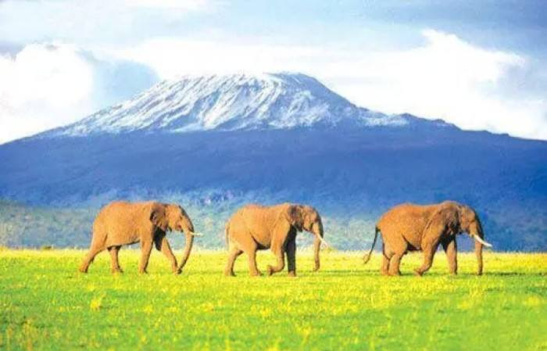
完形填空: 基础性、综合性的代表
说明文：乞力马扎罗山，环保先进单位！大量的游客涌入一定会给环境带来破坏吗？坦桑尼亚国家公园管理局的努力卓有成效。
The best of a Kilimanjaro 50 , in my opinion, isn’t reaching the top. Mountains are 51 as spiritual places by many cultures. This 52 is especially evident on Kilimanjaro as 53 go through five ecosystems（生态系统）in the space of a few kilometers.
50. A. atmosphere B. experience C. experiment D. sight
51. A. studied B. observed C. explored D. regarded
52. A. view B. quality C. reason D. purpose
53. A. scientists B. climbers C. locals D. officials
启示：阅读精泛结合，以课标为依据教学，不受所谓出题惯例束缚。
学科知识综合应用

Slide 37
完形填空: 基础性、综合性的代表
At the base is a rainforest. It ends abruptly at 3, 000 meters, 54 lands of low growing plants. Further up, the weather 55 — low clouds envelope the mountainsides, which are covered with thick grass. I 56 twelve shades of green from where I stand. Above 4, 000 meters is the highland 57 : gravel（砾石）, stones and rocks. 58 you climb into an arctic-like zone with 59 snow and the glaciers that may soon disappear.
54. A. holding on to B. going back to C. living up to D. giving way to
55. A. changes B. clears C. improves D. permits
56. A. match B. imagine C. count D. add
57. A. village B. desert C. road D. lake
58. A. Obviously B. Easily C. Consequently D. Finally
59. A. permanent B. little C. fresh D. artificial
启示：掌握阅读描写文的方法，读出空间感，时间感 思维导图教学。

Slide 38
短文填空
语法填空（共10小题；每小题1.5分，满分15分）
短文改错（共10小题；每小题1分，满分10分）
 | 词数 | 文体 | 名词 | 动词 | 形容词 | 副词 | 代词 | 连词 | 介词 | 冠词
语法填空 2017 | 190 | 记叙 | 2 | 3 |  | 1 | 1 | 1 | 1 | 1
 | 191 | 说明 | 2 | 3 | 1 | 1 |  | 1 | 1 | 1
 | 195 | 说明 | 1 | 4 |  | 1 |  | 3 | 1
2019 卷I | 181 | 说明 | 1 | 4 | 1比较 | 1 |  | 1同位 | 1 | 1
 | 词数 | 文体 | 名词 | 动词 | 形容词 | 副词 | 代词 | 连词 | 介词 | 冠词
短文改错 | 93 | 记叙 | 1 | 2 |  | 1 | 1 | 3 | 1 | 1
 | 106 | 记叙 | 1 | 4 |  |  | 2 | 2 |  | 1
 | 118 | 记叙 | 1 | 3 | 1 | 1 | 2 |  | 1 | 1
2019 卷I | 95 | 记叙 | 3名词复数和短语 | 2 |  | 1词义辨析 | 1 | 2状、并列 |  | 1

Slide 39
启示
情理之中 意料之外是常态 问题的情景总是鲜活的。 生活就是取之不竭，用之不尽的源泉
关于同位语从句的连词
高中英语课程标准指出；“高中阶段的语法教学，应从语言运用的角度出发，把语言的形式、意义和用法有机地结合起来。要引导学生在语 境中了解和掌握语法的表意功能。”
新课程标准提倡的高中语法教学要从用的角度出发。更重要的一点是，要发展学生比较强的语法意识。也就是说，语法教学不能只局限在语法的范畴内，必须与逻辑思维联系起来，与人说话的意识联系起来，与篇章语境
联系起来，与题材、体裁联系起来,与词汇的用法联系起来，与文化联系起来。

Slide 40
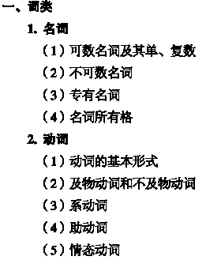
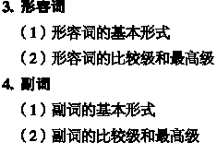
语法
词法10项+句法10项（4）+ 构词法

Slide 41
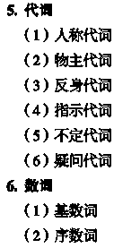
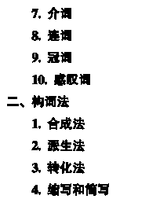
语法

Slide 42
语法
三、句法
句子种类
（1）陈述句
（2）疑问句
（3）祈使句
（4）感叹句
2. 句子成分
主、谓、表、宾、定
状、补
3. 简单句的基本句型
4. 主谓一致
5. 并列复合句
6. 主从复合句
宾语从句
状语从句
定语从句
主语从句
表语从句
同位语从句
7. 间接引语
8. 省略
9. 倒装
10. 强调
11. 虚拟语气

Slide 43
卷I 第二节 书面表达（满分25分）
假定你是李华，暑假在伦敦学习，得知当地美术馆要举办中国画展。请写一封信申请做志愿者，内容包括：
1．写信目的：
2．个人优势：
3．能做的事情。
注意：
1．词数100左右；
2．可以适当增加细节，
以使行文连贯；
3．结束语已为你写好。
话题意义：宣传中国传统文化，树立文化自信
试题：集基础性、拓展性、创新性于一身
一审 作者和读者
二审 目的和文体
三审 情景和要点
情景1 与美术馆交流、需要介绍自己，语言较正式；
情景2 申请做志愿者；
要点1 写信目的：做志愿者；
要点2 个人优势：需要与中国画相关
要点3 能做的事情：个人素养的综合展示
要点4 开头和结尾

Slide 44
卷II第二节 书面表达（满分25分）
假定你是校排球队队长李华。请写封邮件告知你的队友Chris球队近期将参加比赛，内容包括：
1. 比赛信息；
2. 赛前准备；
3. 表达期待。
注意：
1. 词数100左右；
2. 可以适当增加细节，
以使行文连贯。
话题意义：体育教育的重要性
试题：集基础性、拓展性、创新性于一身
一审 作者和读者
二审 目的和文体
三审 情景和要点
情景1 与朋友邮件交流、不需要介绍自己，语言较口语化；
情景2 告知队友近期参加比赛；
要点1 比赛信息：时间、地点、对手；
要点2 赛前准备：热身训练
要点3 表达期待：希望队友参加，希望赢得比赛
要点4 开头和结尾

Slide 45
Possible version
Dear sir,
My name is Li Hua, a Chinese student studying in a summer school in London at the moment. Knowing that you are going to hold a Chinese art exhibition in your gallery, I am writing to apply for a post as a volunteer interpreter.
I’ve been a lover of Chinese painting since early childhood. I even won a few awards for my Chinese brush paintings. My experience of learning Chinese painting has equipped me with the knowledge of the various schools of Chinese paintings, their differing styles, characteristics and approaches in interpreting the outstanding features of Chinese paintings, be it on landscapes, flower and birds, human figures, and other subject matters.

Slide 46
I can speak good English and I have no difficulty in doing presentation on various subjects here in class. I am sure I can be a good volunteer interpreter or a helper with some paper work concerning the Chinese paintings.
I’d appreciate it if you can accept me application. For further information, please send me an email.
Look forward to your reply.
Yours faithfully,
Li Hua

Slide 47
教学启示回顾
落实语篇教学，关注语篇中各种成分之间的相互关系。
1）微观结构特征（micro-structural properties）。语法结构、词汇、以及句子之间的衔接手段
2）宏观结构特征（macro-structural organization）。句子与句子之间，段落与段落之间，以及更大语篇成分之间的逻辑—语义关系（文脉）
2. 关注文体特征（linguistic features）：叙事、报告、论述、广告等。
3. 在情景中学习语音、词汇和语法。
4. 注意发展学生的理解能力和表达能力
提取信息（浅层、深层）、整合信息、传递信息

Slide 48
2020年高考复习建议
语篇测评机制下的高三复习策略

Slide 49
【阅读中的文化教育】（1）
The meaning of silence varies among cultural groups. Silences may be thoughtful, or they may be empty when a person has nothing to say. A silence in a conversation may also show stubbornness, uneasiness, or worry. Silence may be viewed by some cultural groups as extremely uncomfortable; therefore attempts may be made to fill every gap (间隙) with conversation. Persons in other cultural groups value silence and view it as necessary for understanding a person’s needs.
as extremely uncomfortable
as necessary for understanding

Slide 50
【阅读中的文化教育】（2）
Many Native Americans value silence and feel it is a basic part of communicating among people, just as some traditional Chinese and Thai persons do. Therefore, when a person from one of these cultures is speaking and suddenly stops, what maybe implied (暗示) is that the person wants the listener to consider what has been said before continuing. In these cultures, silence is a call for reflection.
Silence is a call for reflection

Slide 51
【阅读中的文化教育】（3）
Many Native Americans value silence and feel it is a basic part of communicating among people, just as some traditional Chinese and Thai persons do. Therefore, when a person from one of these cultures is speaking and suddenly stops, what maybe implied (暗示) is that the person wants the listener to consider what has been said before continuing. In these cultures, silence is a call for reflection.
Silence is a call for reflection

Slide 52
【阅读中的文化教育】（4）
Other cultures may use silence in other ways, particularly when dealing with conflicts among people or in relationships of people with different amounts of power. For example, Russian, French, and Spanish persons may use silence to show agreement between parties about the topic under discussion. However, Mexicans may use silence when instructions are given by a person in authority rather than be rude to that person by arguing with him or her. In still another use, persons in Asian cultures may view silence as a sign of respect, particularly to an elder or a person in authority.
agreement
respect
Showing politeness

Slide 53
【阅读中的文化教育】（5）
Nurses and other care-givers need to be aware of the possible meanings of silence when they come across the personal anxiety their patients may be experiencing. Nurses should recognize their own personal and cultural construction of silence so that a patient’s silence is not interrupted too early or allowed to go on unnecessarily. A nurse who understands the healing (治愈) value of silence can use this understanding to assist in the care of patients from their own and from other cultures.
practical use of the knowledge

Slide 54
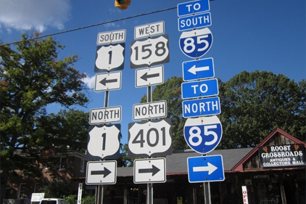
阅读中的文化教育（6）
Larry works with Transport Drivers, Inc. One morning in 2009, Larry was 41 along I65 north after delivering to one of his 42 . Suddenly, he saw a car with its bright lights on. 43 he got closer, he found 44 vehicle upside down on the road. One more look and he noticed 45 shooting out from under the 46 vehicle. Larry pulled over, set the brake and 47 the fire extinguisher (灭火器). Two good bursts from the extinguisher and the fire was put out.
Inc. = incorporated 股份有限公司
（特指股东很少的有限责任公司）
I65 north 美国一条横贯南北的公路

Slide 55
【写作中的文化教育】
（2016卷I）第二节 书面表达（满分25分）
假定你是李华，暑假想去一家外贸公司兼职，已写好申请书和个人简历（resume）。给外教Ms Jenkins 写信，请她帮你修改所附材料的文字和格式（format）。
目的：鼓励教师和学生培养文化交流品质。

Slide 56
【命题思路四】弘扬中华文明 树立民族自信（1）
Chengdu has dozens of new millionaires, Asia’s biggest building, and fancy new hotels. But for tourists like me, pandas are its top 61 (attract).
So it was a great honour to be invited backstage at the not-for-profit Panda Base, where ticket money helps pay for research, I 62 (allow) to get up close to these cute animals at the 600-acre centre. From tomorrow, I will be their UK ambassador. The title will be 63 (official) given to me at a ceremony in London. But my connection with pandas goes back 64 my days on a TV show in the mid-1980s, 65 I was the first Western TV reporter 66 (permit) to film a special unit caring for pandas rescued from starvation in the wild.
熊猫基地行（I）
筷子的历史（III）
帮忙代售中国结（2013）

Slide 57
【命题思路四】弘扬中华文明 树立民族自信（2）
My ambassadorial duties will include 67 (introduce) British visitors to the 120-plus pandas at Chengdu and others at a research in the misty mountains of Bifengxia.
On my recent visit, I held a lively three-month-old twin that had been rejected by 68 (it) mother. The nursery team switches him every few 68 (day) with his sister so that while one is being bottle-fed, 70 other is with mum ― she never suspects.
题型：知识应用题型和表达题型中
目的：旨在鼓励教师和学生用英语传播中华文明

Slide 58
【命题思路五】潜移默化 鼓励创新
2016 II B
Five years ago, when I taught art at a school in Seattle, I used Tinkertoys as a test at the beginning of a term to find out something about my students. I put a small set of Tinkertoys in front of each student, and said: “Make something out of the Tinkertoys. You have 45 minutes today ― and 45 minutes each day for the rest of the week.”
目的：旨在对教师和学生起到潜移默化的鼓励作用，促使他们教创新、学创新，以实际行动践行社会主义核心价值观。

Slide 59
【命题思路六】保持开放 学以致用 （1）
(2016卷I)第二节 书面表达（满分25分）
假定你是李华，暑假想去一家外贸公司兼职，已写好申请书和个人简历（resume）。给外教Ms Jenkins 写信，请她帮你修改所附材料的文字和格式（format）。注意：
1. 词数100左右；
2. 可以适当增加细节，已使行文连贯。
生活中怎么用就怎么考。 Test the language as it is used in real life.

Slide 60
【命题思路六】保持开放 学以致用（2）
(2016卷II)第二节 书面表达（满分25分）
假定你是李华，你校摄影俱乐部（photography club）将举办国际中学生摄影展。请给你的英国朋友Peter写封信。请他提供作品。信的内容包括：
1．主题：环境保护；
2．展览时间；
3．投稿邮箱：intlphotoshow@gmschool.com.
1. 词数100左右；
2. 可以适当增加细节，已使行文连贯。
生活中怎么用就怎么考。 Test the language as it is used in real life.

Slide 61
【命题思路六】保持开放 学以致用（3）
(2016卷III)第二节 书面表达（满分25分）
假定你是李华，与留学生朋友Bob约好一起去书店，因故不能赴约。请给他写封邮件，内容包括：
1．表示歉意；
2．说明原因；
3．另约时间。
1. 词数100左右；
2. 可以适当增加细节，已使行文连贯。
生活中怎么用就怎么考。 Test the language as it is used in real life.

Slide 62
【命题思路七】重视基础 削枝强干(1)
考查主干知识
（2016卷I ）
If you feel stressed by responsibilities at work, you should take a step back and identify (识别) those of 61 (great) and less importance. Then, handle the most important tasks first so you’ll feel a real sense of 62 (achieve). Leaving the less important things until tomorrow 63 (be) often acceptable.
Most of us are more focused 64 our tasks in the morning than we are later in the day. So, get an early start and try to be as productive 65 possible before lunch. This will give you the confidence you need to get you through the afternoon and go home feeling accomplished.
61. greater 62. achievement 63. is 64. on 65. as

Slide 63
【命题思路七】重视基础 削枝强干(2)
知识题考查主干知识
（2016卷I ）
Recent 66 (study) show that we are far more productive at work if we take short breaks 67 (regular). Give your body and brain a rest by stepping outside for 68 while, exercising, or dong something you enjoy.
If you find something you love doing outside of the office, you’ll be less likely 69 (bring) your work home. It could be anything -gardening, cooking, music, sports—but whatever it is, 70 (make) sure it’s a relief from daily stress rather than another thing to worry about.
66. studies 67. regularly 68. a 69. to bring 70. make

Slide 64
【命题思路七】重视基础 削枝强干(3)
知识题考查主干知识
（2016卷I ）
The summer holiday is coming. My classmates and I are talking about how to do during the holiday. We can chose between staying at home and take a trip. If we stay at home, it is comfortable but there is no need to spend money. But in that case, we will learn little about ∧world. If we go on a trip abroad, we can broaden you view and gain knowledges we cannot get from books. Some classmates suggest we can go to places of interest nearby. I thought that it is a good idea. It does not cost many, yet we can still learn a lot.
71. what 72. choose 73. taking 74. and 75. the 76. our 77. knowledge
78. should 79. think 80. much

Slide 65
【命题思路七】重视基础 削枝强干(4)
知识题考查主干知识
（2016卷I ）
设题特点1 主干知识上设题
设题特点2 中国学生易犯语言错误
设题特点3 考察点包括词法、句法和行文逻辑
词法 | 名词 | 动词 | 代词 | 形容词 | 副词 | 冠词 | 介词 | 连词
 | 62, 66, 77 | 69，72，73， | 76, 80 | 61 | 66, 71 | 68, 75 | 64 | 74
句法 | 比较级 | 祈使句 | 固定句式 | 时 态 | 非 谓 | 主谓一致
句法 | 65 | 70 | 78 | 79 | 69，73 | 63

Slide 66
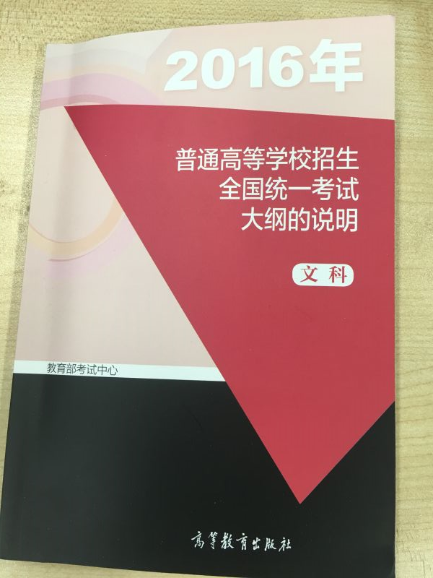
英语基础知识回顾
2016英语考试说明
要求考生了解和掌握《普通高中英语课程标准（实验）》附录中所列出的各项内容、也包括 附录I语音项目、附录II 语法项目、附录III功能意念项目、附录IV 话题项目和附录V词汇表。

Slide 67
英语基础知识回顾
附录1 语音项目表
1. 基本读音
2. 重音
3. 读音的变化
(1) 连读 at eight o’clock in the morning
(2) 失去爆破
(3) 弱读
(4) 同化
4. 语调与节奏
(1) 意群与停顿
(2) 语调
(3) 节奏
5. 语音、语调、重音、节奏等在口语交流中的运用

Slide 68
英语基础知识回顾(1)
3. 数词
(1) 基数词
(2) 序数词
4. 介词和介词短语
5. 连词
6. 形容词(比较级和最高级)
7. 副词(比较级和最高级)
8. 冠词
附录2 语法项目表
1. 名词
(1) 可数名词及其单复数
(2) 不可数名词
(3) 专有名词
(4) 名词所有格
√
√
√
√
√
√
√
2. 代词
(1) 人称代词
(2) 物主代词
(3) 反身代词
(4) 指示代词
(5) 不定代词
(6) 疑问代词
√
√
9. 动词
(1) 动词的基本形式
(2) 系动词
(3) 及物动词和不及物动词
(4) 助动词
(5) 情态动词
√
√
√
√
√
√

Slide 69
英语基础知识回顾(2)
11. 被动语态
12. 非谓语动词
(1) 动词不定式
(2) 动词的-ing形式
(3) 动词的-ed形式
√
附录2 语法项目表
10. 时态
(1) 一般现在时
(2) 一般过去时
(3) 一般将来时
(4) 现在进行时
(5) 过去进行时
(6) 过去将来时
(7) 将来进行时
(8) 现在完成时
(9) 过去完成时
(10) 现在完成进行时
√
√
√
15. 句子成分
(1) 主语
(2) 谓语
(3) 表语
(4) 宾语
(5) 定语
(6) 状语
(7) 补语

Slide 70
英语基础知识回顾(4)
20. 间接引语
21. 省略
22. 倒装
23. 强调
24. 虚拟语气
√
附录2 语法项目表
16. 简单句的基本句型
17. 主谓一致
18. 并列复合句
19. 主从复合句
(1) 宾语从句
(2) 状语从句
(3) 定语从句
(4) 主语从句
(5) 表语从句
√
√
√
√
√
√
√

Slide 71
英语知识运用试题分析
第一节完形填空（共20小题；每小题1.5分，满分30分）
语言知识运用
（满分45分）
第二节语法填空（共10小题；每小题1.5分，满分15分）
 | 词数 | 文体 | 名词 | 动词 | 形容词 | 副词 | 代词 | 连词 | 介词 | 冠词
完形填空 | 250 | 记叙 | 4 | 9 | 2 | 1 | 1 | 2 | 1
 | 264 | 记叙 | 4 | 6 | 5 | 3 |  |  | 2
 | 275 | 记叙 | 6 | 7 | 3 | 2 | 1 | 1
语法填空 | 190 | 记叙 | 2 | 3 |  | 1 | 1 | 1 | 1 | 1
 | 191 | 说明 | 2 | 3 | 1 | 1 |  | 1 | 1 | 1
 | 195 | 说明 | 1 | 4 |  | 1 |  | 3 | 1
Notes:
动词包括谓语动词、非谓语动词、动词短语
介词包括介词短语

Slide 72
【命题思路八】重视技能 侧重阅读（1）
阅读理解（40）+15
完形填空（30）+10
短文填空（15） +5
短文改错（10）
阅读理解单词量
125分
 | 阅读理解 | 完形填空 | 短文填空 | 短文改错 | 总数
2016 I | 1940 | 250 | 190 | 93 | 2473
2016 II | 1842 | 190 | 191 | 106 | 2329
2016III | 1811 | 275 | 195 | 118 | 2399

Slide 73
【命题思路八】倡导语篇 考查语用（1）
语篇（discourse）指的是实际使用的语言单位，是交流过程中的一系列连续的语段或句子所构成的语言整体。从功能上来说，它相当于一种交际行为。总的说来，语篇由一个以上的语段或句子组成，其中各成分之间，在形式上是衔接（Cohesion）的，在语义上是连贯（Coherence）的。
21.Jack_________ in the lab when the power cut occurred.
A. works B. has worked C. was working D. would work
答案：C
能力要求：句子理解，时态理解
出题特点：在语境中考查基础知识。

Slide 74
【命题思路八】倡导语篇 考查语用（2）
语篇（discourse）指的是实际使用的语言单位，是交流过程中的一系列连续的语段或句子所构成的语言整体。从功能上来说，它相当于一种交际行为。总的说来，语篇由一个以上的语段或句子组成，其中各成分之间，在形式上是衔接（Cohesion）的，在语义上是连贯（Coherence）的。
（2016卷III）30. What does the underlined phrase “a pipe dream” in
Paragraph 3 mean?
A. A practical idea. B. A vain hope.
C. A brilliant plan. D. A selfish desire.
There are also varieties developed to suit specific local conditions. One of the very best varieties for eating quality is Orleans Reinette, but you’ll need a warm, sheltered place with perfect soil to grow it, so it’s a pipe dream for most apple lovers who fall for it.

Slide 75
【命题思路八】倡导语篇 考查语用（3）
Visiting an apple event is a good chance to see, and often taste, a wide variety of apples. To people who are used to the limited choice of apples such as Golden Delicious and Royal Gala in supermarkets, it can be quite an eye opener to see the range of classical apples still in existence, such as Decio which was grown by the Romans. Although it doesn’t taste of anything special, it’s still worth a try, as is the knobbly (多疙瘩的) Cat’s Head which is more of a curiosity than anything else.
There are also varieties developed to suit specific local conditions. One of the very best varieties for eating quality is Orleans Reinette, but you’ll need a warm, sheltered place with perfect soil to grow it, so it’s a pipe dream for most apple lovers who fall for it.
A. A practical idea. B. A vain hope. C. A brilliant plan. D. A selfish desire.
答案：B
能力要求：语篇理解，衔接理解，语义理解

Slide 76
【命题思路九】能力立意 综合考查 （阅读篇）
阅读微技能 | 卷 I | 卷 II | 卷 III
1、理解主旨要义 | 35 | 32， | 35
2、理解文中具体信息 | 21，22，23，25，26，27，31，33，34， | 21，24，25，28，31，33，34，35 | 21，22，23，24，25，28， 32，34，
3、根据上下文推断单词和短语的含义 | 29， | 27，30， | 26，30
4、作出简单的判断和推理 | 24，30， | 22，23，26， | 27，29，33，
5、理解文章的基本结构 | 36-40 | 36-40 | 36-40
6、理解作者的意图、观点和态度 | 28，32 | 29， | 31，

Slide 77
阅读典型题例（1）主旨
（2016卷I）35. What may be the best title for the text?
A. Sound and Silence B. What It Means to Be Silent
C. Silence to Native Americans D. Speech Is Silver; Silence Is Gold
The meaning of silence varies among cultural groups. Silences may be thoughtful, or they may be empty when a person has nothing to say. A silence in a conversation may also show stubbornness, uneasiness, or worry. Silence may be viewed by some cultural groups as extremely uncomfortable; therefore attempts may be made to fill every gap (间隙) with conversation. Persons in other cultural groups value silence and view it as necessary for understanding a person’s needs.
答案：A
能力要求：语篇理解，归纳主旨大意，
基础知识要求：词汇，语法，话题

Slide 78
阅读典型题例（2）细节
（2016卷II）21. Who can help you if you want to have your music produced?
A. Jules Skye. B. Gee Whizz.
C. Charlotte Stone. D. James Pickering.
Electric Underground
7.30pm－1.00am Free at the Cyclops Theatre
Do you know who’s playing in your area? We’re bringing you an exciting evening of live rock and pop music from the best local bands. Are you interested in becoming a musician and getting a recording contract (合同)? If so, come early to the talk at 7.30pm by Jules Skye, a successful record producer. He’s going to talk about how you can find the right person to produce your music.
答案：A 能力要求：语篇理解，提取信息，
基础知识要求：词汇，语法，话题，文体

Slide 79
阅读典型题例（3）推测词义
（2016卷II）27. What does the underlined word “downside” in Paragraph 4
probably mean?
A. Mistake. B. Drawback. C. Difficulty. D. Burden.
Encouraging this kind of thinking has a downside. I ran the risk of losing those students who had a different style of thinking. Without fail one would declare, “But I’m just not creative.”
答案：B
能力要求：语篇理解，推测词义，
基础知识要求：词汇，语法，话题，文体
解体技能：细读意群，找到线索词句，

Slide 80
阅读典型题例（3）推理判断
（2016卷II）24. What can we infer about the women mentioned in the text?
A. They are highly educated. B. They are truly creative.
C. They are pioneers. D. They are peace-lovers.
Jane Addams (1860-1935)
Anyone who has ever been helped by a social worker has Jane Addams to thank. Addams helped the poor and worked for peace. She encouraged a sense of community(社区) by creating shelters and promoting education and services for people in need. In 1931, Addams became the first American woman to win the Nobel Peace Prize.

Slide 81
阅读文本
Rachel Carson (1907-1964)
If it weren’t for Rachel Carson, the environmental movement might not exist today. Her popular 1962 book Silent Spring raised awareness of the dangers of pollution and the harmful effects of chemicals on humans and on the world’s lakes and oceans.
Sandra Day O’Connor (1930-present)
When Sandra Day O’Connor finished third in her class at Stanford Law School, in 1952, she could not find work at a law firm because she was a woman. She became an Arizona state senator(参议员) and ,in 1981, the first woman to join the U. S. Supreme Court. O’Connor gave the deciding vote in many important cases during her 24 years on the top court.
pioneer，creative
pioneer，

Slide 82
阅读典型题例（3）推理判断
（2016卷II）24. What can we infer about the women mentioned in the text?
A. They are highly educated. B. They are truly creative.
C. They are pioneers. D. They are peace-lovers.
Rosa Parks (1913-2005)
On December 1, 1955, in Montgomery, Alabama, Rasa Parks would not give up her seat on a bus to a passenger. Her simple act landed Parks in prison. But it also set off the Montgomery bus boycott. It lasted for more than a year, and kicked off the civil-rights movement. “The only tired I was, was tired of giving in,” said Parks.
答案：C
能力要求：语篇理解，归纳整合信息，分辨信息
基础知识要求：词汇，语法，话题，文体
解体技能：收集线索词句，

Slide 83
阅读典型题例（4）意图
（2016卷III）31. What is the author’s purpose in writing the text?
A. To show how to grow apples. B .To introduce an apple festival.
C. To help people select apples. D. To promote apple research.
Apple Days are being held at all sorts of places with an interest in fruit, including stately gardens and commercial orchards (果园). If you want to have a real orchard experience, try visiting the National Fruit Collection at Brogdale, near Faversham in Kent.
答案：B
能力要求：语篇理解，理解文体的作用，
基础知识要求：词汇，语法，话题，文体

Slide 84
阅读典型题例（5）文章结构
38 Fresh fish should smell sweet: you should feel that you’re standing at the ocean’s edge. Any fishy or strong smell means the fish isn’t fresh. 39 When you have bought a fish and arrive home, you’d better store the fish in the refrigerator if you don’t cook it immediately, but fresh fish should be stored in your fridge for only a day or two. Frozen fish isn’t as tasty as the fresh one.
√
A. Do not buy it.
B. The easiest is to steam it.
C. This is how you can do it.
D. It just requires a little knowledge.
E. The fish will go bad within hours.
F. When buying fish, you should first smell it.
G. The fats in fish are thought to help prevent heart disease.
答案：F A
能力要求：语篇理解，句群结构理解基础知识要求：词汇，语法，话题，文体，衔接，连贯，
√

Slide 85
【命题思路九】能力立意 综合考查（写作篇）
写作微技能 | 卷 I | 卷 II | 卷 III
1、清楚、连贯地传递信息，表达意思 | 给外教Mr Jenkins 写信，请她帮你修改所附材料的文字和格式（format）。 | 给英国朋友Peter写封信。请他提供作品参加校摄影俱乐部（photography club）将举办国际中学摄影展。 | 是给留学生朋友Bob写一封道歉信，说明因故不能如约一起去书店。
2、有效运用所学语言知识 | 文体，话题，词汇，语法，功能 | 文体，话题，词汇，语法，功能 | 文体，话题，词汇，语法，功能
在语篇中考查考生综合运用语言的能力；
五个附录中的基本知识是听、读、写能力的基础；
命题思路：贴近生活，学以致用

Slide 86
写作典型题例
(2016卷III)第二节 书面表达（满分25分）
假定你是李华，与留学生朋友Bob约好一起去书店，因故不能赴约。请给他写封邮件，内容包括：
1．表示歉意；
2．说明原因；
3．另约时间。
1. 词数100左右；
2. 可以适当增加细节，已使行文连贯。
生活中怎么用就怎么考。 Test the language as it is used in real life.

Slide 87
评分标准
第一档 （25分）完全完成了试题规定的任务。
内容完整，条理清楚。
交际得体，表达时充分考虑到了交际的需求；体现出较强的语言运用能力。
完全达到了预期的写作目的。
关键词：内容、条理、交际、语言能力

Slide 88
（2016卷III） 内容要点：1.表示歉意 2. 说明原因 3. 另约时间
Dear Bob,
I’m sorry to say that I cannot go to the bookstore with you on Friday afternoon. I have just found that I have to attend an important class meeting that afternoon. I hope the change will not cause you too much trouble.
Shall we go on Saturday morning? We can set out early so that we’ll have more time to read and select books. If it’s convenient for you, let’s meet at 8:30 outside the school gate. If not, let me know what time suits you best. I should be available any time after school next week.
Yours,
Li Hua
评语：
内容完整、条理清晰、交际得体、语言能力强

Slide 89
阅读理解命题技巧
1、不是正确答案而是最佳选项。
第一节（共15小题；每小题2分，共30分）
阅读下列短文，从每题所给的A、B、C、D四个选项中，选出最佳选项，并在答题卡上将该项涂黑。

Slide 90
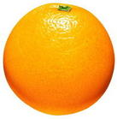
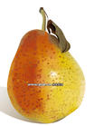
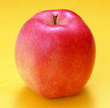
请选出不是水果的一项
A B
C. D.
相比之下最为合理的选项！

Slide 91
The Basics of Math—Made Clear
58. What can we learn about Professor H. Siegel?
A. He is a guest lecturer at Kentucky Educational Television.
B. He is to deliver 30 lectures in Basic Math.
C. He works in Georgia State University.
D. He specializes in training teachers.

Slide 92
The Basics of Math—Made Clear
Basic Math introduces students to the basic concepts of mathematics, as well as the fundamentals of more tricky areas. These 30 fantastic lectures are designed to provide students with an understanding of arithmetic and to prepare them for Algebra(代数) and beyond. If the course fails to provide complete .
…
Professor H. Siegel, honored by Kentucky Educational Television as “the best math teacher in America,” is a devoted teacher and has a gift for explaining mathematical concepts in ways that make them seem clear and obvious. From the basic concrete ideas to the more abstract problems, he is master in making math lectures learner-friendlier and less scary.

Slide 93
The Basics of Math—Made Clear
With a PhD in Mathematics Education from Georgia State University, Dr. Siegel teaches mathematics at Central Arizona College. His courses include various make-up classes and a number of lectures for future primary school teachers.
58. What can we learn about Professor H. Siegel?
A. He is a guest lecturer at Kentucky Educational Television.
B. He is to deliver 30 lectures in Basic Math.
C. He works in Georgia State University.
D. He specializes in training teachers.

Slide 94
命题的玄机大揭秘（2）
2、偷梁换柱 混淆视听
1）以偏代全，以细节代整体
His courses include various make-up classes and a number of lectures
for future.
2）夸张：利用信息呈现跨度大的事实，过度推断,成功诱导。
通过夸大程度may—must/can
（all, nothing, only, nobody）
3）通过改变定语或状语改变定义。
He specializes in training teachers.

Slide 95
利用信息差成功误导
64. We can learn from the passage that people under pressure tend to ______.
A. keep rewards better in their memory
B. recall consequences more effortlessly
C. make risky decisions more frequently
D. learn a subject more effectively
But the findings further suggest that stress may bring about a double effect. Not only are rewarding experiences remembered better, but negative consequences are also easily recalled.

Slide 96
A new review based on a research shows that acute stress affects the way the brain considers the advantages and disadvantages, causing it to focus on pleasure and ignore the possible negative (负面的) consequences of a decision.

Slide 97
都是状语惹的祸
I began to grow up that winter night when my parents and I were returning from my aunt’s house, and my mother said that we might soon be leaving for America. We were on the bus then. I was crying, and some people on the bus were turning around to look at me. I remember that I could not bear the thought of never hearing again the radio program for school children to which I listened every morning.

Slide 98
I do not remember myself crying for this reason again. In fact, I think I cried very little when I was saying goodbye to my friends and relatives. When we were leaving I thought about all the places I was going to see—the strange and magical places I had known only from books and pictures. The country I was leaving never to come back was hardly in my head then.
57. Upon leaving for America the author felt _____________ . （38%）
A. confused B. excited C. worried D. amazed

Slide 99
命题的玄机大揭秘（3）
利用可能发生的错误—信息定位错误。
65. According to the research, stress affects people most probably in their ______.（57%）（障眼法？字词理解？）
A. ways of making choices
B. preference for pleasure
C. tolerance of punishments
D. responses to suggestions

Slide 100
The research suggests that stress may change the way people make choices in predictable ways.
…
This phenomenon is likely not surprising to anyone who has tried to resist eating cookies or smoking a cigarette while under stress –at those moments, only the pleasure associated with such activities comes to mind. But the findings further suggest that stress may bring about a double effect. Not only are rewarding experiences remembered better, but negative consequences are also easily recalled.

Slide 101
66. The research has proved that in a stressful situation, ______.
A. women find it easier to fall into certain habits
B. men have a greater tendency to slow down
C. women focus more on outcomes
D. men are more likely to take risks

Slide 102
This tendency to slow down and become more cautious when decisions are risky might also help explain why women are less likely to become addicted than men: they may more often avoid making the risky choices that eventually harden into addiction.
在作出决定需要承担风险的时候，这种趋势会减缓或更加谨慎。也许这一点可以说明为什么女人比男人更不太可能做出有风险的决定：也许女人更会规避做出冒险的决定，更不会养成做出冒险决定的习惯。
66. The research has proved that in a stressful situation, ______.
A. women find it easier to fall into certain habits
B. men have a greater tendency to slow down
C. women focus more on outcomes
D. men are more likely to take risks

Slide 103
标点符号
冒号
3．用于总说性话语的后边，表示引起下文的分说。 北京紫禁城有四座城门：武门、神武门、东华门、西华门。
4．用于需要解释的词语后边，表示引出解释或说明。 外文图书展销会
This tendency to slow down and become more cautious when decisions are risky might also help explain why women are less likely to become addicted than men: they may more often avoid making the risky choices that eventually harden into addiction.

Slide 104
破折号 ──
1．用于行文中解释说明的部分。
And aren’t the new e-readers – like the Kindle, which has just flown past? Harry Potter and the Deathly Hallows to become Amazon’s best-selling product ever – kinder to the planet?
2．用于话题突然转变。It is so hot today!—When are you leaving? He asked Leo.

Slide 105
读懂、读快
(CNN)—Randall Stephenson, CEO of AT&T, was watching the Olympics with his daughter when she saw it—an ad featuring a man in a wheelchair suffering from a severe brain injury and holding a sign with the text: “Where r.”
“This is the text message that caused the car accident that changed my life forever,” the man said.

Slide 106
何为长难句？
句子成分的复杂程度，直接引语，人称代词的指代；省略句；背景知识
According to Stephenson, the ad did its job. “She said, ‘Dad ... that’s heavy’,” he said. “I said, it’s supposed to be heavy. It got your attention and that’s what we’re trying to accomplish.”
Seeing the ad on TV, Stephenson’s daughter felt it _______.
A. unbelievable B. creative
C. attractive D. unpleasant

Slide 107
小结
命题思路一 结构稳定 内容创新
命题思路二 选材面广 内容丰富
命题思路三 引领价值观 助力文化品格养成
命题思路四 弘扬中华文明 树立民族自信
命题思路五 潜移默化 鼓励创新
命题思路六 保持开放 学以致用
命题思路七 重视基础 削枝强干
命题思路八 倡导语篇 考查语用
命题思路九 重视技能 侧重阅读
命题思路九 能力立意 综合考查
命题思路十 立足整体 细节设陷

